Slide 1
Hospital Data Analysis
Guided by : Mr. Sumit Patil Sir

Slide 2
METHODOLOGY
DATA REQUIREMENT.
DATA CLEANING.
DATA MODELLING.
DATA ANALYSIS.
DATA VISUALIZATION.

Slide 3
DATA REQUIREMENT
Data Collection plays important role in Data Analysis. Collect data from trusted sources. Need to Analyze given Hospital Data to understand the Data, Columns, Description of Data. It is also known as Data Gathering Phase.
Required Files :
Inpatient.csv : Holds data of Patients who Stayed at least 1 Night in Hospital.
Outpatient.csv : Holds data of Patients who visited Hospital only for Medicinal or Prescription purpose.
Mapping_Speciality.csv : Holds data of Speciality with their Speciality Groups in detailed.

Slide 4
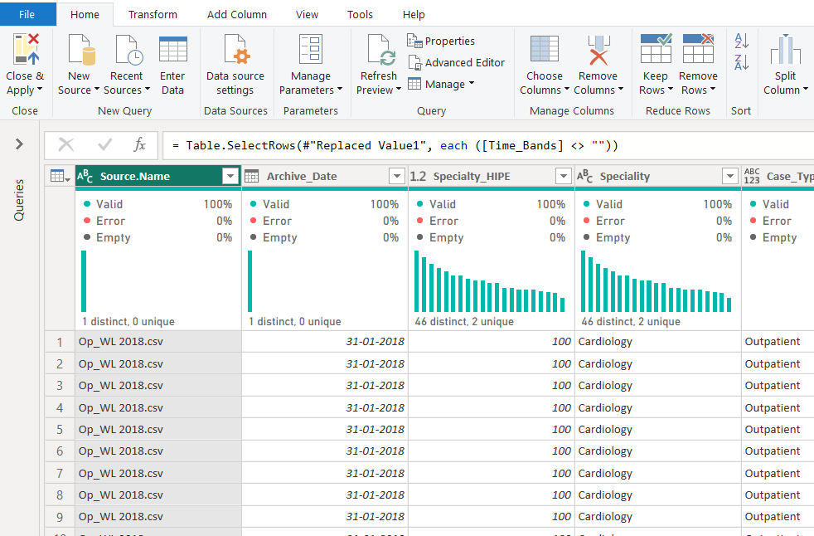
DATA CLEANING
DATA TRANSFORMATION : Transform data from the one form to the another form.
Data Cleaning plays important role in data analytics.
Focus : POWER QUERY EDITOR.
Data Spliting
Data Sorting
Data Extraction
Remove Errors
Remove Duplicate
Remove Columns
Fill Missing Values
Feature Selection
Feature Creation.

Slide 5
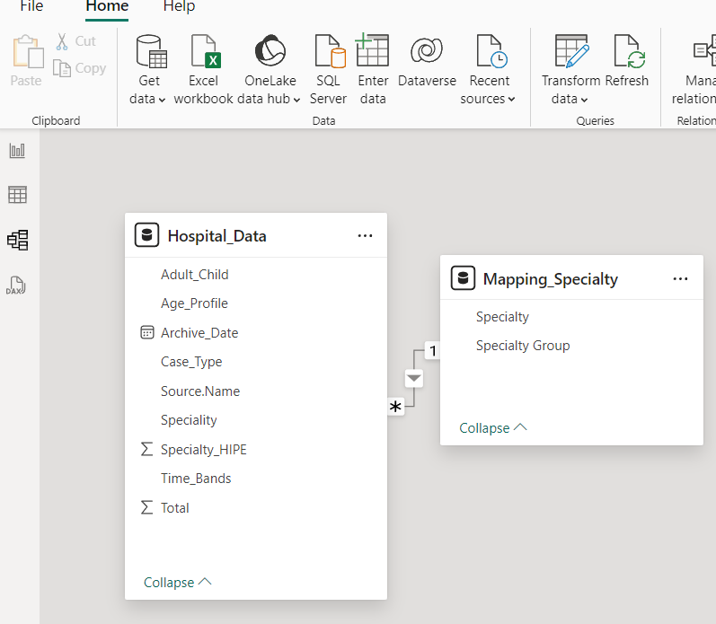
DATA MODELING
Establish Relationship between different Tables based on Common Column or Common Data.
Perform Joins between Tables.
Relationships :
One to One
One to Many
Many to One
Many to Many

Slide 6
DATA ANALYSIS (DAX)
Perform Data Analysis (DAX) on data for Calculation purpose, To create new measures or columns to get better insights from the data.
Functions Used : FILTER, CALCULATE, SUMX, AVERAGEX, MAXX, EDATE, SWITCH
TOTAL PATIENTS
AVERAGE PATIENTS
TOTAL REGULAR QRT PATIENT
TOTAL PAST QRT PATIENT
COMPARE CURRENT VS PAST QRT PATIENTS DATA

Slide 7
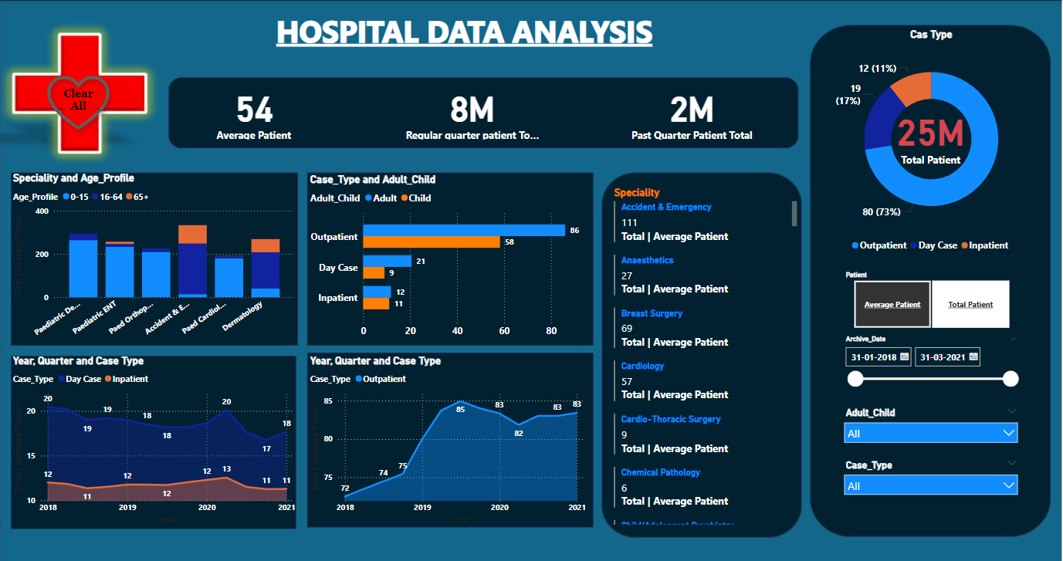
DASHBOARD

Slide 8
MEASURES
25 M
TOTAL PATIENT
54
AVERAGE PATIENT
8 M
REGULAR QRT.
2 M
PASGT QRT.
TOAL PATIENT : Total Number of Patient Admitted to Hospital.
AVERAGE PATIENT : Average Number of Patient.
REGULAR QUARTER PATIENT : Indicates Number of Patient Visited in Current Quarter.
PAST QUARTER PATIENT : Indicates Number of Patient Visited in Past Quarter. (frequency)

Slide 9
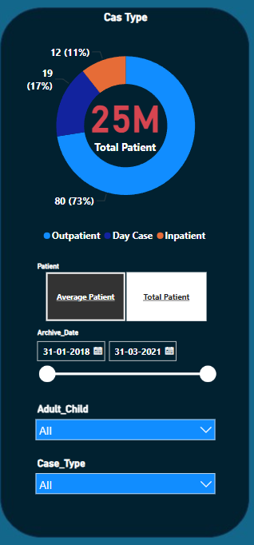
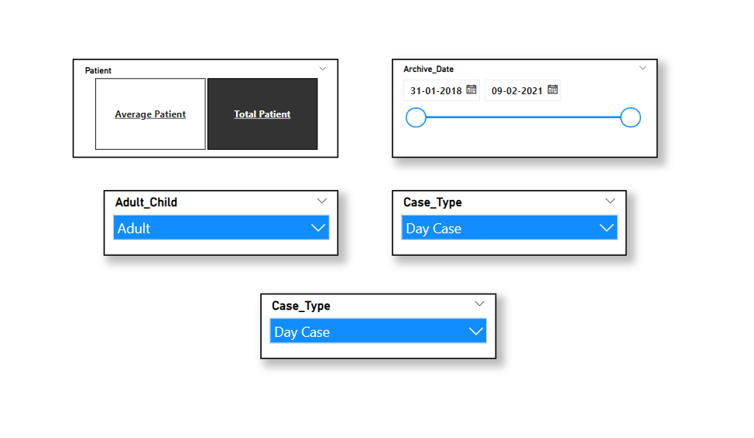
Slicers Chart.

Slide 10
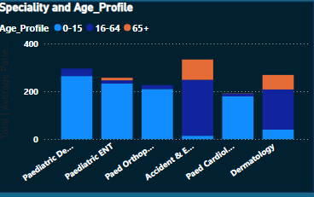
Stacked Column Chart.
Stacked Column Chart :
Above Chart Represents Different Speciality according to Patient Age Profile
This chart shows total values for each category while breaking it into sub-categories.
Make easy for comparision and show distribution .
Clear visual for multiple dataset, can compare complex data easily.

Slide 11
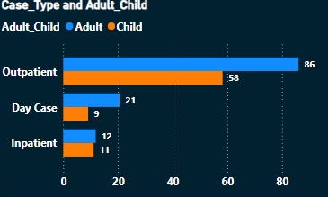
Clustered Bar Chart.
Clustered Bar Chart :
Represents Relationship between Case Type with Adult & Child.
Adults are more as compared to Childs in every Case Type – Inpatient, Outpatient, Day Case.
Multiple bars group together to show comparision in better way.
Difference between group can easily seen.
Can displayed Vertically as well as Horizontally as per requirement.

Slide 12
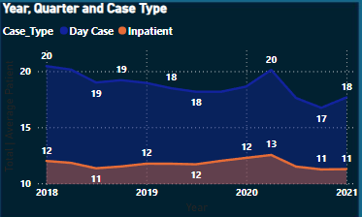
Area Chart
Area Chart :
Represents Co-relation between Case Types & Years – Day Case and Inpatient on Yearly basis.
Visual trends over time – Years, Months, Weeks, Days.
Display Quantitative Data over charts.
Display Contribution of different components.

Slide 13
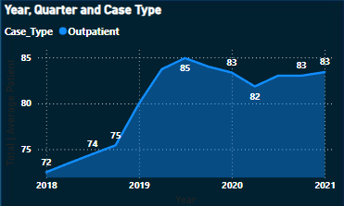
Area Chart.
Areas Chart :
Represents Outpatient data on basis of Year
Number of Outpatients Increasing continuously
Helps to track growth or reduction of outpatient cases.

Slide 14
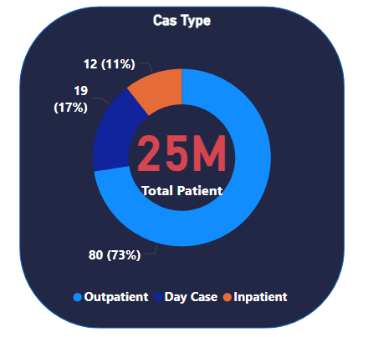
Donut Chart.
Dounut Chart :
Represents Total Number of Patients based on Case Type.
Day Case : Patients who Stayed/Admitted for Procedure or Treatment purpose. (Surgery)
Outpatient : Patients who Visited Hospital for Medicinal or Prescription purpose.
Inpatient : Patients who Stayed/Admitted in Hospital for at least 1 Night.

Slide 15
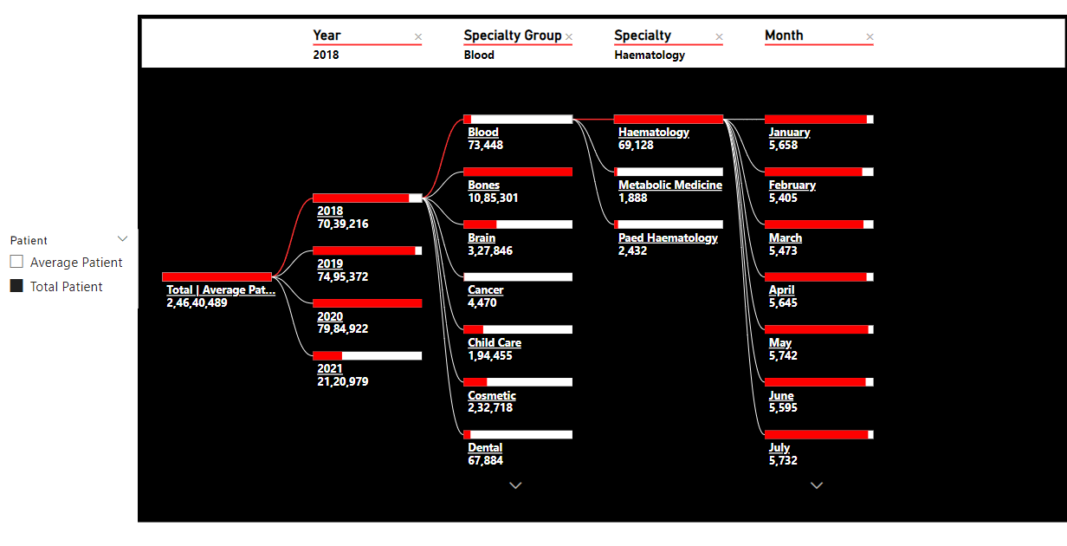
DATA TREE
DATA TREE :
It is Graphical Representation of Outpatient data on basis of Year, Speciality Group, Speciality and Month.
It Identifies Trends, Patterns and Area of Improvement.
Data Tree Structure :
Year (Root) -> Speciality Group -> Speciality -> Month.

Slide 16
THE END

